Slide 1
Physical activity fitness prediction
Yatham tunish royal
Sandeep tammina
Kalidindi sai arun varma
Pothala satya vinay

Slide 2
introduction
OVERVIEW:
Sedentary lifestyle is defined by the absence of physical activity practices throughout the day and causes a decrease in caloric expenditure. This behavior is explained by the inappropriate lifestyle, for example, too much time sitting or lying down and still eating unhealthy foods during this time of immobilization. Currently, a third of the adult world population is physically inactive and this generates 5 million deaths per year (The LAncet, 2012). In addition to contributing to several chronic diseases, physical inactivity also influences mood, sleep quality and body weight

Slide 3
INTRODUCTION
PURPOSE:
The objective of the project is answering a simple question, “does exercise/working-out improve a person’s activeness?”. For the scope of this project a person’s activeness was the measure of their daily step-count (the number of steps they take in a day). We are going to build a Machine Learning model which predicts the activeness or inactiveness of a person based on the Mood and number of steps taken in a day. Mood was measured in either "Happy", "Neutral" or "Sad" which were given numeric values of 300, 200 and 100 respectively. Feeling of activeness was measured in either "Active" or "Inactive" which were given numeric values of 500 and 0 respectively.

Slide 4
LITERATURE SURVEY
The importance of physical activity and physical education in the prediction of academic achievement.
Tara A Stevens, Yen To, Sarah J Stevenson, Marc R Lochbaum
Journal of Sport Behaviour 31 (4), 2008
The purpose of the present investigation was to determine the independent contributions of physical activity not associated with structured physical education and school based physical education participation to academic achievement in children. Prior academic achievement and socioeconomic status were also examined Elementary school participants were selected from the Early Childhood Longitudinal Study-Kindergarten database. Structural equation models were constructed for both mathematics (boys, n= 3,226; girls, n= 3,256) and reading achievement (boys, n= 3,167; girls, n= 3,226). Physical activity was significantly and positively related to both mathematics and reading achievement in boys and girls. Physical education participation was not significantly related to achievement. Socioeconomic status accounted for approximately 26% of the physical activity. Future longitudinal research is discussed that incorporates more comprehensive physical activity and achievement variables.
EXISTING PROBLEM:

Slide 5
LITERATURE SURVEY
PROPOSED SOLUTION:
Accelerometery-based activity monitors have become the standard objective method for assessing physical activity (PA) in field-based research [1]. They are small, non-invasive, easy-to use, and provide an objective indicator of physical activity over extended periods of time. The main advantage from a research perspective is they provide an objective indicator of physical activity behavior, thereby avoiding common sources of error in subjective measurement (eg, self-report). Because of their storage data capacity, it is possible to monitor behavior over extended periods of time and easy to download the information to a computer for processing. Numerous studies have been published on the reliability and validity of various accelerometry-based physical activity monitors. They have become widely accepted in the field.

Slide 6
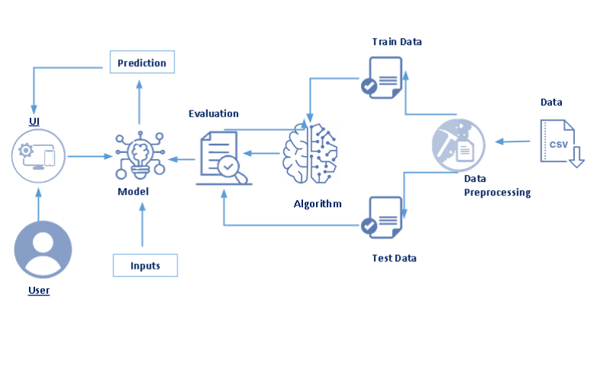
THEORETICAL ANALYSIS
BLOCK DIAGRAM:

Slide 7
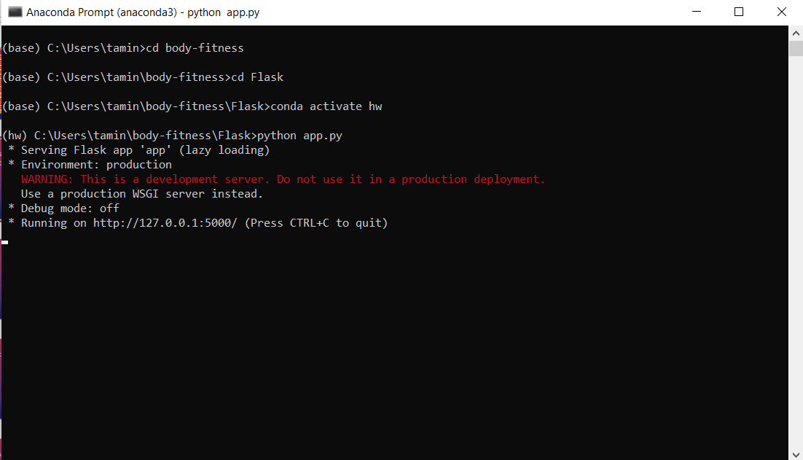
THEORETICAL ANALYSIS
SOFTWARE DESIGNING:
We firstly open anaconda prompt and change the directory to the required folder where we can finally launch the application by which we will be provided with a local host address(http://127.0.0.1:5000/) and then if we copy paste in website the application will be launched. Everything is crystal clear so that the person who uses would not be facing any difficulties.

Slide 8
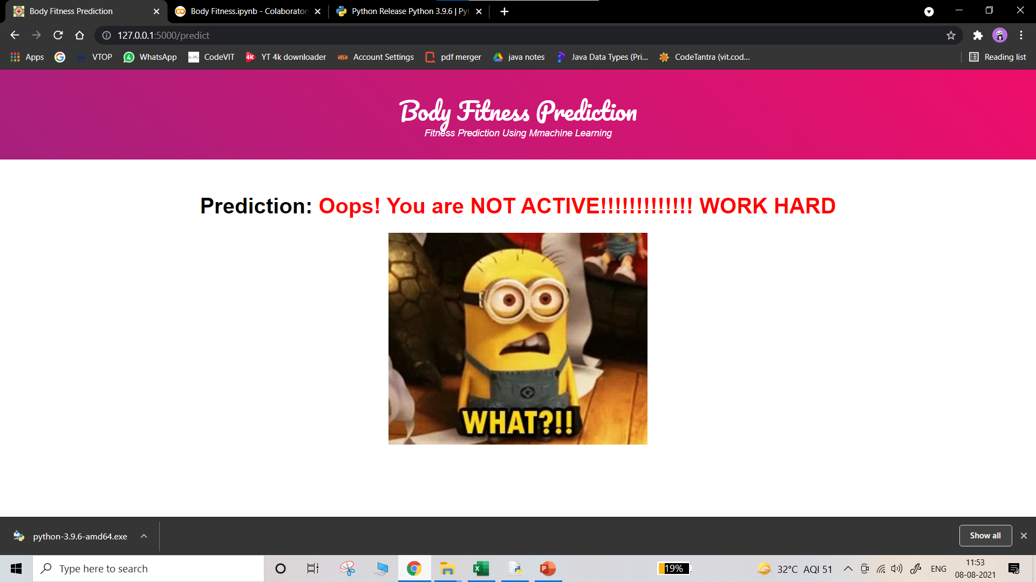
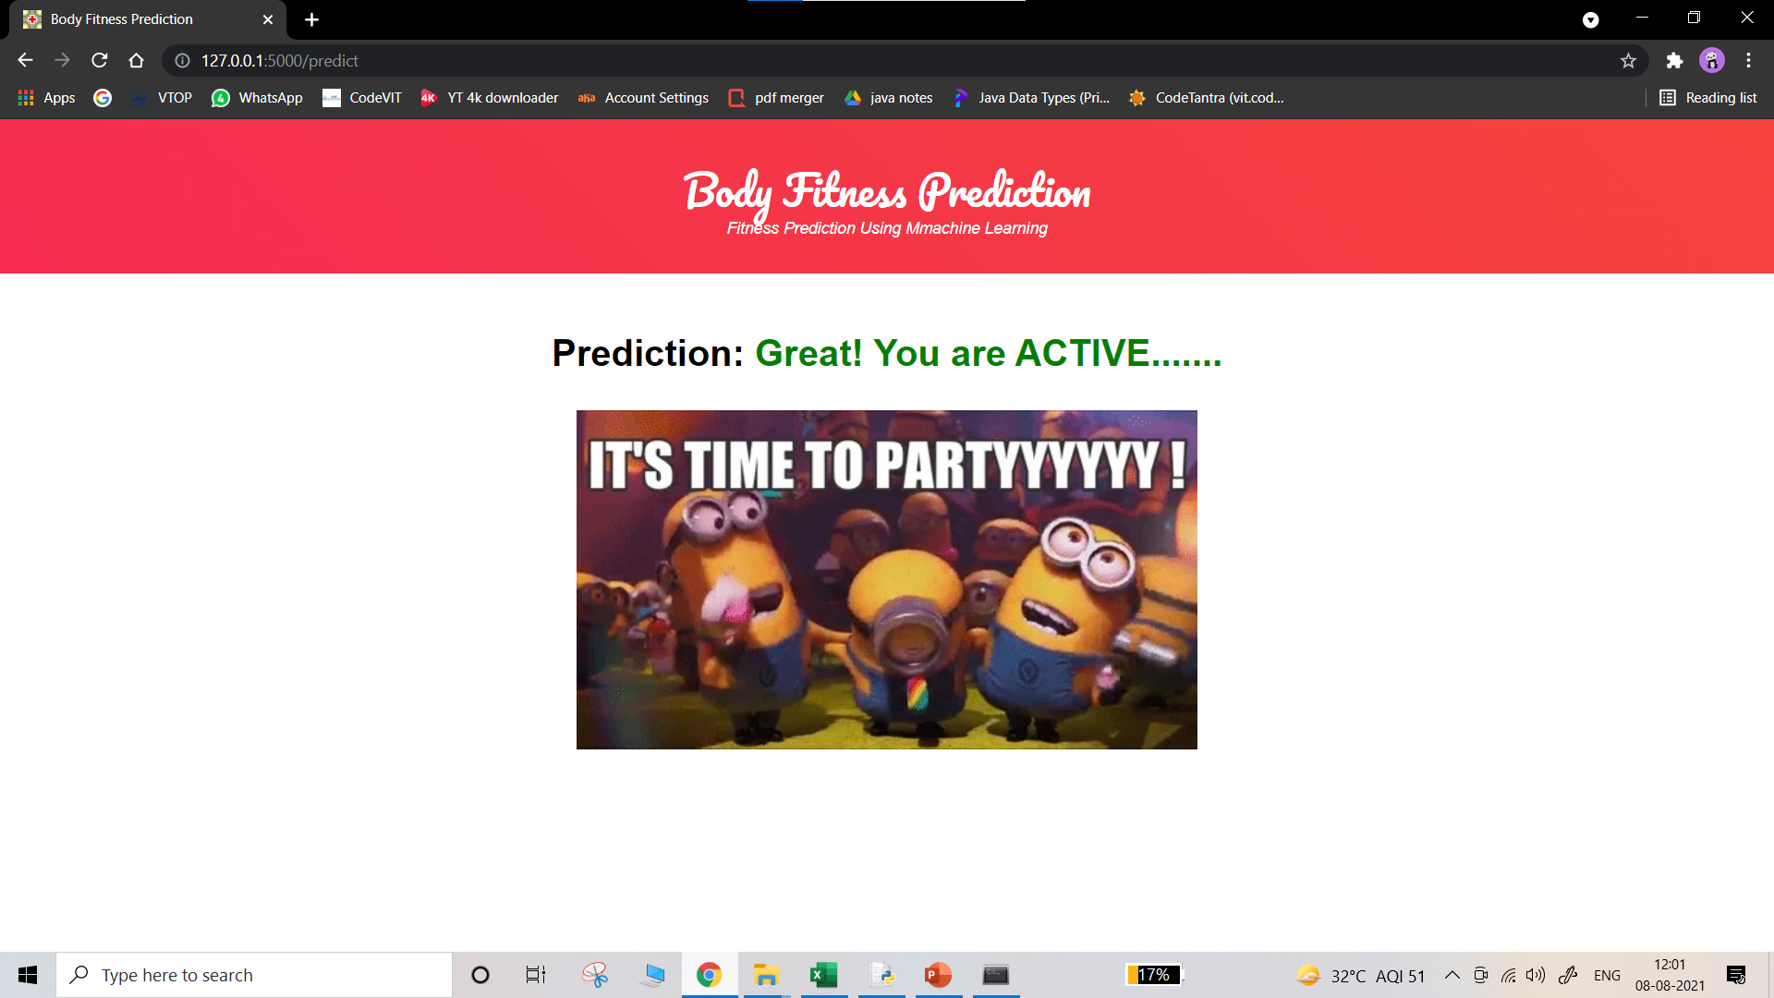
EXPERIMENTAL INVESTIGATIONS
If we keep a certain data set like: Output will be like
:
If the data set changed then: Output will be changed to:
6041 100 197 8 0 66
step_count | mood | calories_burned | hours_of_sleep | bool_of_active | weight_kg
5464 | 200 | 181 | 5 | 0 | 66

Slide 9
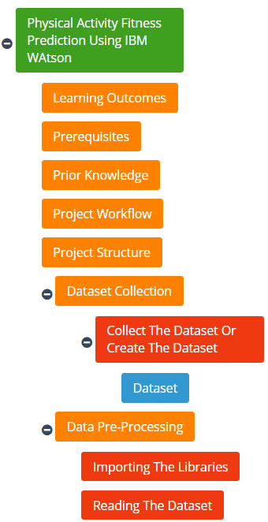
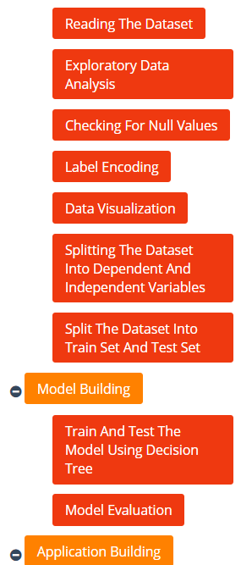
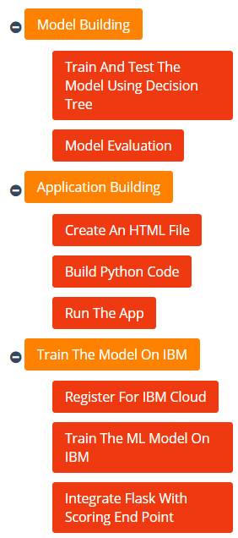

FLOWCHART

Slide 10
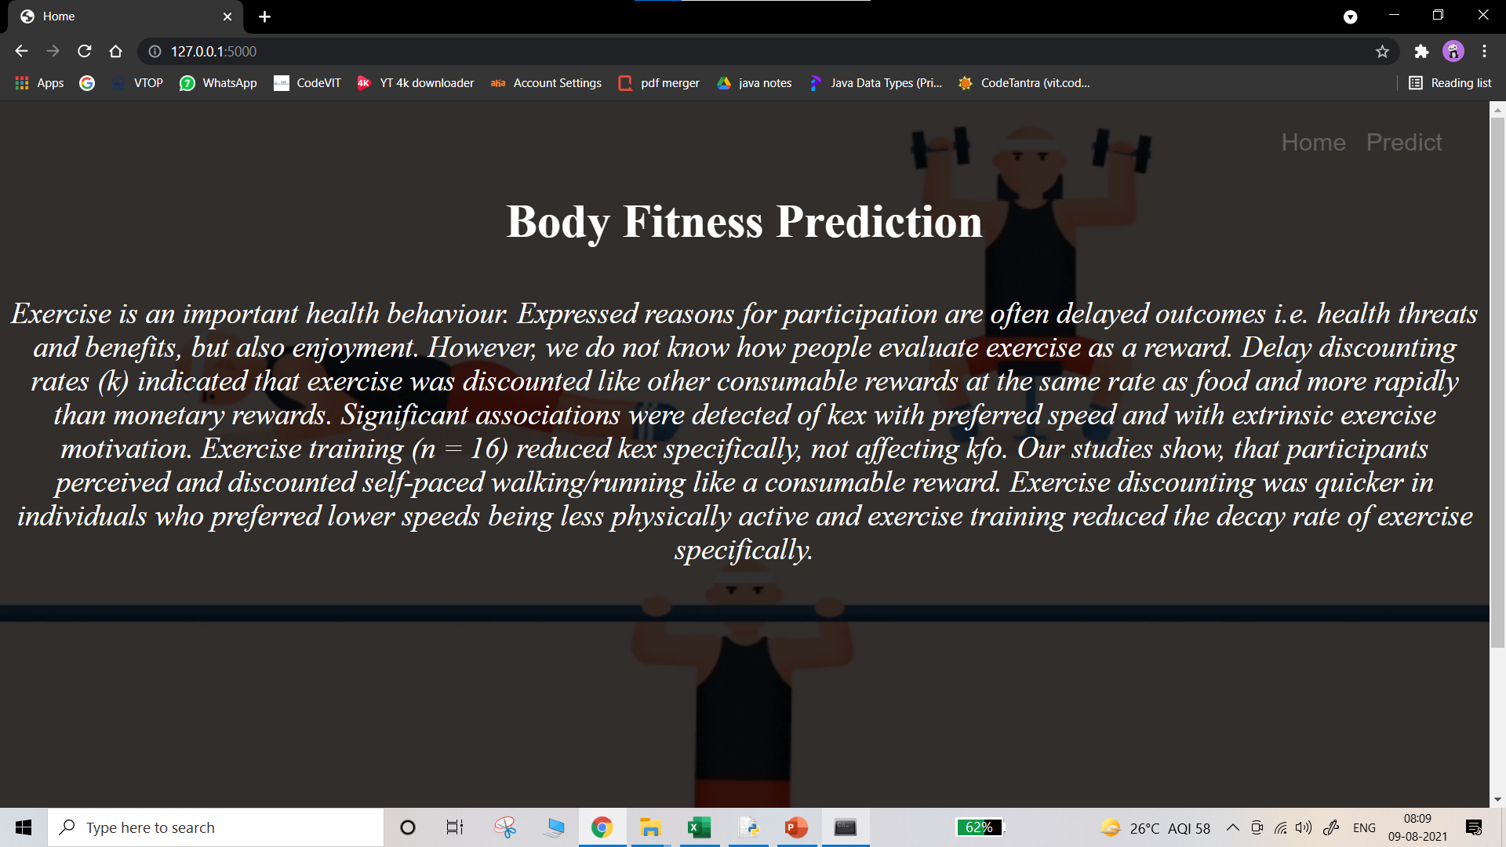
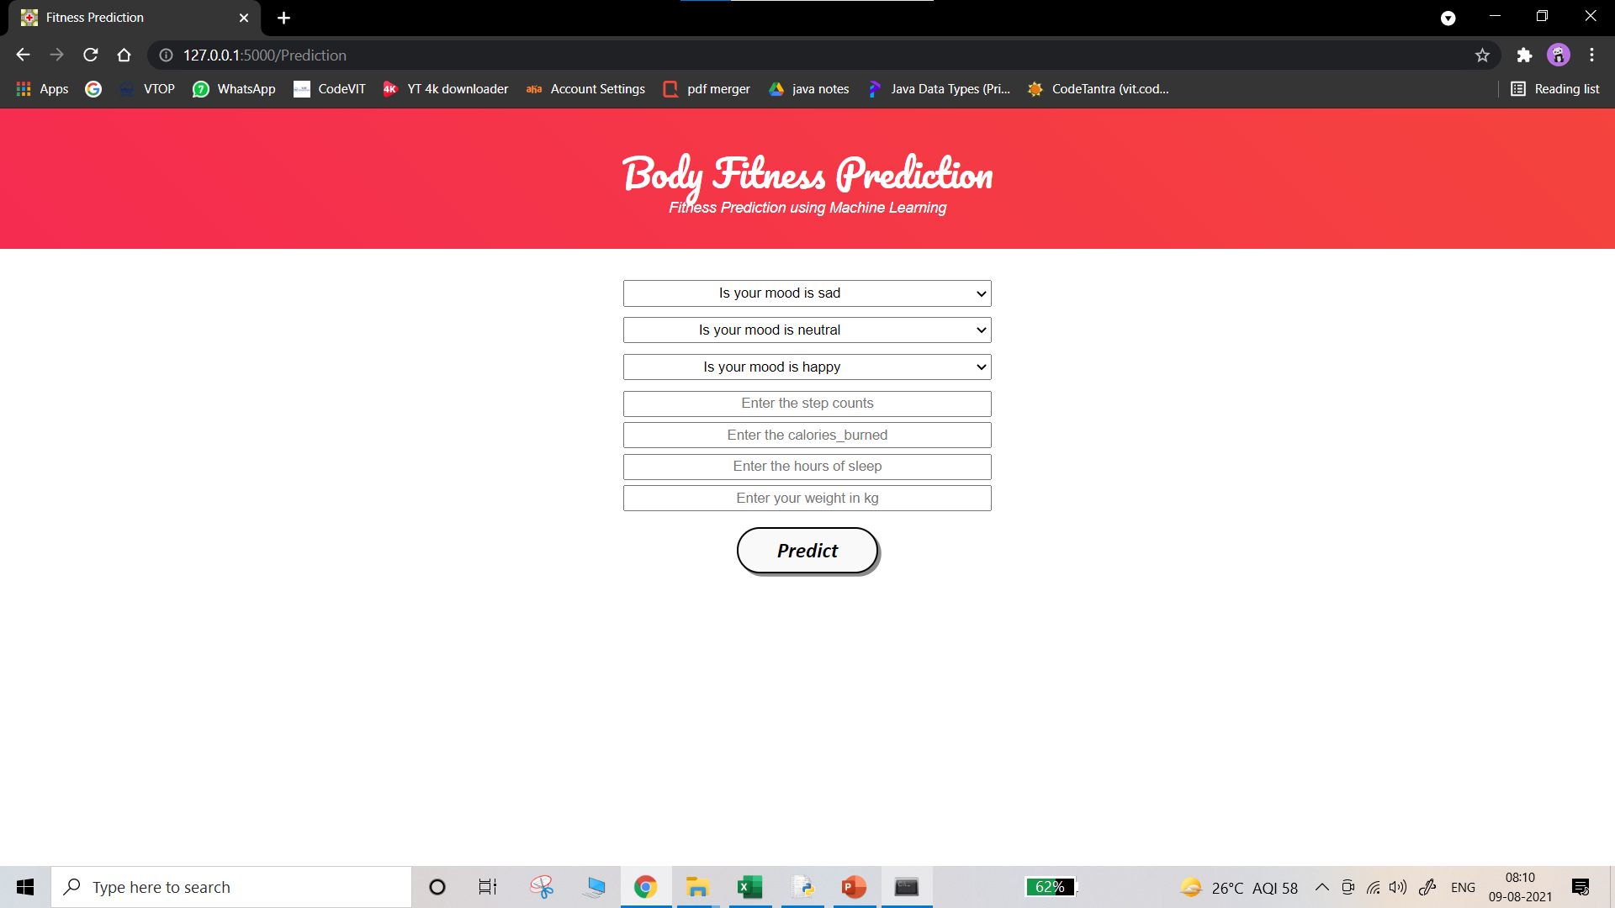
RESULT
So the result of the project can be seen below as we created a local host and it has two options HOME and PREDICTION and introduction, further proceeding the next step we enter the values asked, to get the required output.

Slide 11
APPLICATIONS
Softwares used are Anaconda Prompt, Python IDE, Google Collab.
We can further develop this into huge model and implement in smartphone world. Where a person himself will be aware of their physical fitness.
We can develop front end where a person get motivated with messages and graphics displayed.
Addition of more features like BMI, weight reduction tips etc.

Slide 12
CONCLUSION
In the past few years, when you said “mobile fitness” to someone, the first thought they might have is “Fitbit.” True, fitness trackers were the driving force behind mobile fitness at first, but that moment of domination is over. Today’s top apps are MyFitnessPal, Fitbit and Samsung Health. The definition of “tracker” has expanded from steps to more sophisticated combinations of diet, exercise and even sleep. Just a few years ago, there were about 50 unique sleep trackers in the app stores, now there are thousands. Furthermore, one of the biggest jumps we saw during past few months, other than fitness tracking, has been consumers looking up new workout routines and recording meals, calories and water intake. This indicates a new level of awareness of personal health, as well as a need for variety and exposure to new types of physical activity.
To paraphrase Steve Jobs, who once paraphrased another certain titan of industry, people don’t know what they want until you show it to them. Now that consumers have had exposure to all the different ways mobile can help them with their health and fitness, they will always want more diverse types of apps to fulfil those (new) needs.

Slide 13
FUTURE SCOPE
Before the COVID-19 outbreak, half of mobile app users were using a mobile device to fulfill their health and fitness goals. That number is now 75%, and nearly 4 in 10 (38%) of respondents said their mobile usage for fitness and nutrition has gone up since the Coronavirus pandemic. That seems completely normal, of course, as there is no in-person option, and mobile is the clear choice for fitness. Many activities, like jogging, are “on the go,” and those who are working from home likely have desktop fatigue so even home workouts would take place on mobile vs. their laptop.
But it’s not just about increased use; this trend is also about new habits that are forming, namely, new types of apps people are using. Some 22% of those surveyed downloaded new apps for health or exercise. And while retention levels of fitness apps could be as difficult to maintain as new gym memberships, I believe that activities like using exercise videos (vs. in-person training) are seeing rates of 28% and those could easily stick. As of now, predictions stand that the global fitness app market will reach nearly $15 billion by 2026, and I think that is realistic.

Slide 14
BIBLIOGRAPHY
Starting Strength: Basic Barbell Training (Paperback) ...
Strength Training Anatomy (Paperback) ...
The 4-Hour Body: An Uncommon Guide to Rapid Fat-Loss, Incredible Sex, and Becoming Superhuman (Hardcover)
We have chosen these books because the psychological terms of humans is explained and the feedback of so many people regarding physical fitness and diet and mental health is productively phrased by the authors

Slide 15
APPENDIX
SOURCE CODE:
import numpy as np
import pandas as pd
from flask import Flask, render_template, request
import pickle
app = Flask(__name__) # initializing a flask app
model = pickle.load(open('fitness.pkl', 'rb')) #loading the model
@app.route('/')# route to display the home page
def home():
return render_template('home.html') #rendering the home page
@app.route('/Prediction',methods=['POST','GET'])

Slide 16
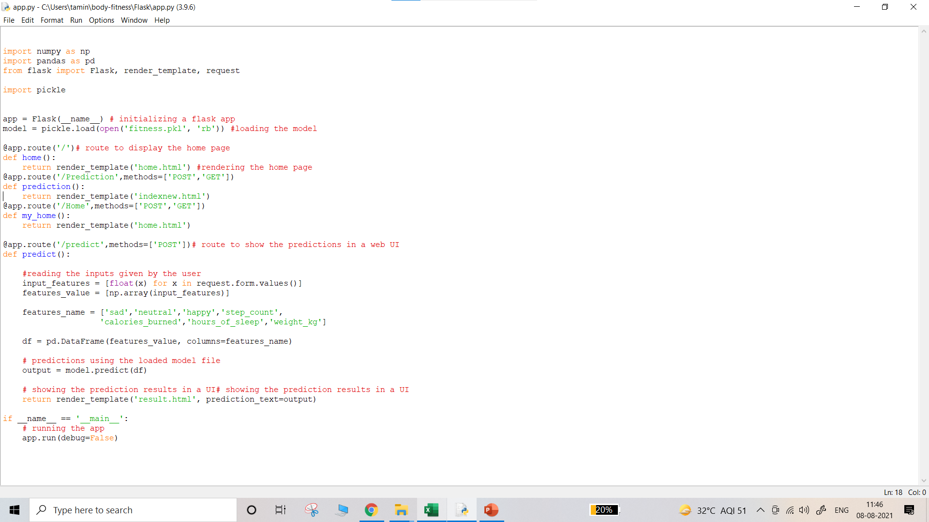
def prediction():
return render_template('indexnew.html')
@app.route('/Home',methods=['POST','GET'])
def my_home():
return render_template('home.html')
@app.route('/predict',methods=['POST'])# route to show the predictions in a web UI
def predict():
#reading the inputs given by the user
input_features = [float(x) for x in request.form.values()]
features_value = [np.array(input_features)]
features_name = ['sad','neutral','happy','step_count',
'calories_burned','hours_of_sleep','weight_kg']
df = pd.DataFrame(features_value, columns=features_name)
# predictions using the loaded model file
output = model.predict(df)
# showing the prediction results in a UI# showing the prediction results in a UI
return render_template('result.html', prediction_text=output)
if __name__ == '__main__':
# running the app
app.run(debug=False)

Slide 17
APPENDIX
UI Output Screenshot:

Slide 18
APPENDIX
UI Output Screenshot:

